Slide 1
Monday Mar. 17 Do Now:
Describe or draw the differences between reflection and refraction.

Slide 2
Learning Objectives: Students will understand the importance of natural frequency and how it is used in real life applications.
Students will understand the positive and negative applications of resonance.
Success Criteria: Students will accurately apply natural frequency and resonance in their lab activity.

Slide 3
Frequency Review
Frequency is:
- Measure of how often a wave goes up
and down
Measured in Hertz (Hz);
One Hertz is one cycle per second

Slide 4
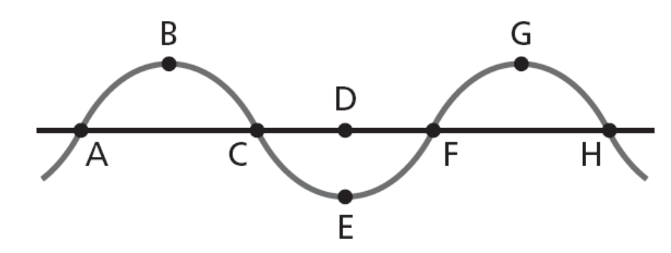
Frequency Review-Example
What is the frequency of this wave?
From point A to F is one wavelength. At F the wave begins to repeat its form.
Frequency is number of cycles (wavelengths) per one second. For this wave, one wavelength takes 2 seconds so:
f=1cycle/2 sec. = 0.5 Hz
2 seconds

Slide 5
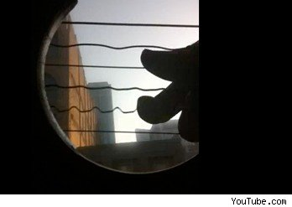
Natural Frequency
Most objects vibrate when hit, struck, plucked, strummed, or somehow disturbed. If you drop a meter stick or pencil on the floor, it will begin to vibrate. If you pluck a guitar string, it will begin to vibrate. If you blow air over the top of a pop bottle, the air inside will vibrate.
http://www.videobash.com/video_show/high-speed-camera-guitar-strings-28853

Slide 6
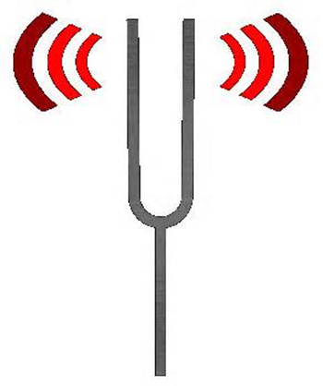
Natural Frequency
When an object vibrates, it tends to vibrate at a particular frequency. The frequency at which an object tends to vibrate when disturbed is the natural frequency of the object.

Slide 7
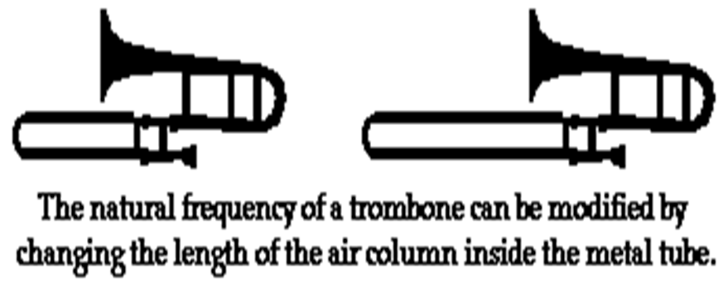
Natural Frequency
The frequency at which an object will vibrate is determined by a variety of factors. Each of these factors will affect the wavelength or the speed of the object. Since
frequency = speed/wavelength,
a change in speed or wavelength will change the natural frequency.

Slide 8
Natural Frequency
The vibrating portion of a particular string can be shortened by pressing the string against one of the frets on the neck of the guitar. This modification in the length of the string would affect the wavelength of the wave and in turn the natural frequency at which a particular string vibrates.
https://video.search.yahoo.com/video/play;_ylt=A2KLqILANCZTmg4AHrD7w8QF;_ylu=X3oDMTEwb25mNWVtBHNlYwNzcgRzbGsDdmlkBHZ0aWQDVjE1MgRncG9zAzEz?p=playing+chords+on+a+guitar&vid=a485c337de3c8f5fd2167c6d3cb711b4&l=1%3A37&turl=http%3A%2F%2Fts4.mm.bing.net%2Fth%3Fid%3DVN.608046023479526239%26pid%3D15.1&rurl=http%3A%2F%2Fwww.youtube.com%2Fwatch%3Fv%3DBEeh4T03aoo&tit=Bass+Guitar+%3A+Learn+to+Play+Chords+on+the+Bass+Guitar&c=12&sigr=11a523s0q&sigt=11li9v73g&pstcat=arts+culture+and+entertainment&age=0&&tt=b

Slide 9
Natural Frequency
Natural frequencies are important to know to:
-to determine how an object will vibrate
-to know what kind of wave an object
will make if disturbed
-to make an object produce a specific
kind of wave
Products in which this is important include:
Microwave ovens, cell phones, musical instruments, bridges, buildings, cars and trucks

Slide 10
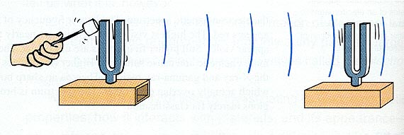
Resonance
Resonance happens when an object is vibrated by an outside force at its natural frequency.
Both tuning forks below have the same natural frequency. The sound wave from the tuning fork on the left is causing the tuning fork on the right to vibrate even though the tuning fork on the right is not being stuck.

Slide 11
Resonance
Resonance is an important way to transfer power into waves. It is used in microwave ovens, musical instruments, and lasers.
Resonance can also be destructive if a structure is designed to have a natural frequency close to that of its surroundings.
Take a look at the example of a bridge built in Tacoma, Washington in 1940.
http://www.youtube.com/watch?v=3mclp9QmCGs

Slide 12
Wed. March 19 Do Now:
What is the difference between natural frequency and resonance?
List 2 applications where knowledge of resonance is important.

Slide 13
Learning Intention: Students will apply knowledge of natural frequency and resonance.
Students will know they are successful when they have accurately completed the lab activity.

Slide 14
Students will do Investigation 12.2 sections 1-3 today and sections 4-5 tomorrow.

Slide 15
Thurs. March 20 Do Now:
Sketch a wave that is vibrating at its 3rd harmonic.
http://www.musclecarszone.com/engine-rebuild-11-months-3000-photos-and-a-lot-of-coffee-in-only-220-sec/

Slide 16
QUIZ ON NATURAL FREQUENCY AND RESONANCE TOMORROW!!
Complete Investigation 12.2 Sections 1-5.
The more you do and the more detail you use in answering questions, the better your grade will be! If you don’t do this you will get a 0.
If you get finished, see Ms. Bandoian for a review packet to work on for next week’s unit test on waves.

