Slide 1
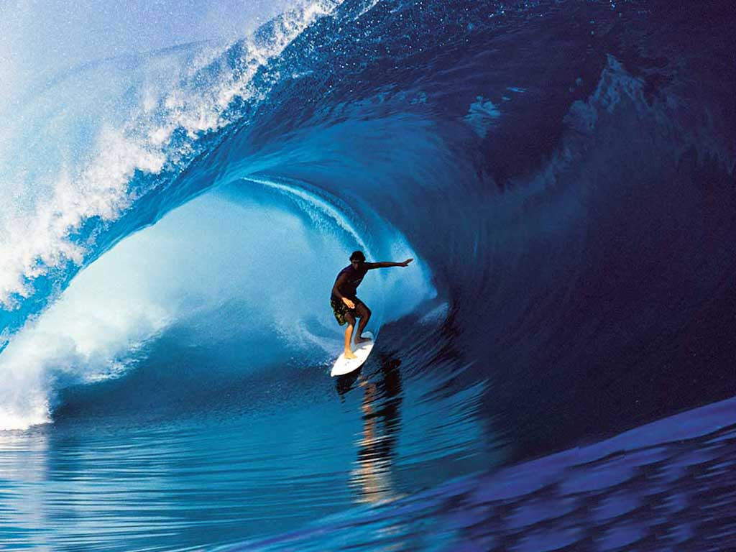
Do Now:
Take the waves pre-test – tell me what you already know about waves as we start our new unit

Slide 2
Mon. Feb. 24 Do Now:
List as many kinds of waves as you can think of.

Slide 3
Objectives:
Learning Intentions –
  Students will be able to identify different types of waves
  Students will be able to classify different examples of waves
Success Criteria –
  We will know we are successful when we can accurately demonstrate different forms of waves and classify examples as different types of waves

Slide 4
What is a Wave?
A wave is an oscillation that travels from one place to another
  Oscillation: back and forth motion
Carry information and energy over great distance

Slide 5
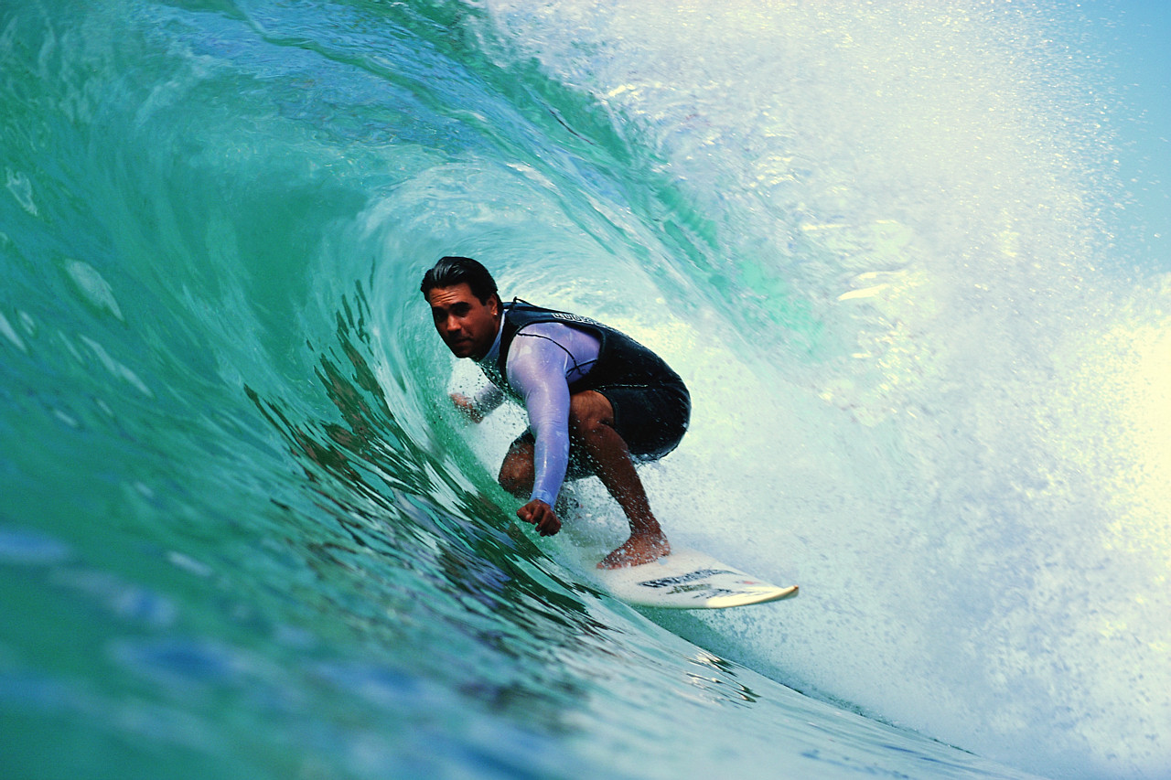

A wave does NOT carry matter with it! It just moves the matter as it goes through it.
Notes:
Think of a stadium wave: the people are moving up and down, but the wave goes around the stadium

Slide 6
Some waves do not need matter (called a “medium”) to be able to move (for example, through space).
These are called electromagnetic waves (or EM waves).
Some waves MUST have a medium in order to move. These are called mechanical waves.

Slide 7
Types of Waves
Sound
Water
Seismic
Light
Microwave
Radio

Slide 8
Properties ALL Types of Waves have in common
Back and forth movement
Carry energy
  Waves also carry information such as sound, pictures, or even numbers.

Slide 9
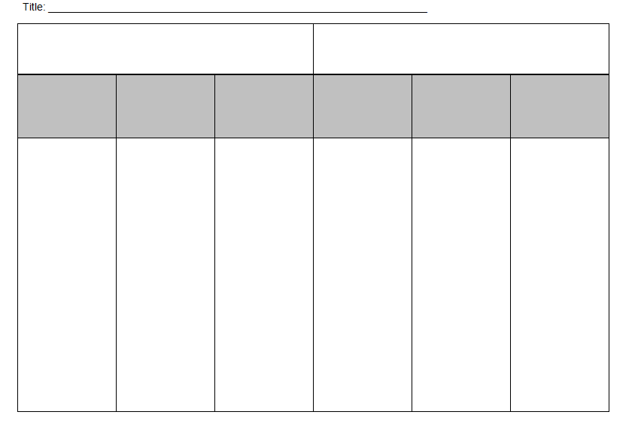
Sound
Water
Seismic
Light
Microwave
Radio

Slide 10
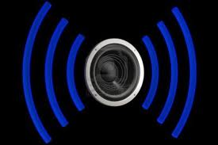
Sound Waves
Travels through air carrying vibrations we recognize as sound

Slide 11

Water Waves
Water spreads out carrying an oscillation to other places

Slide 12
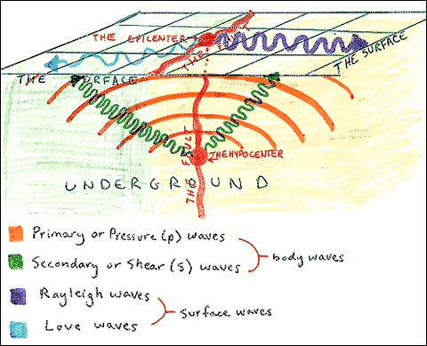
Seismic Waves
Waves of energy that travel through Earth’s layers
Result from an earthquake or volcano

Slide 13
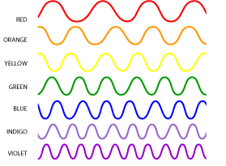
Light Waves
Electromagnetic waves that are visible to humans
Each color’s wave is slightly different

Slide 14
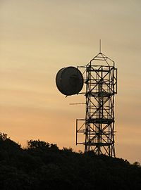
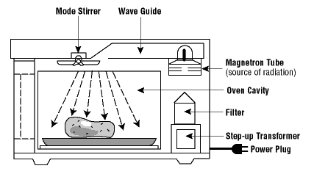
Microwaves
Waves that carry phone conversations
Microwave ovens
Waves emitted by the sun
Radar
GPS

Slide 15

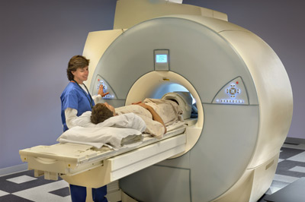
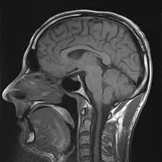
Radio Waves
Carries sound to your stereo
Carries television signals
WiFi
MRI – magnetic resonance imaging
  Uses radio waves to generate images of the human body

Slide 17
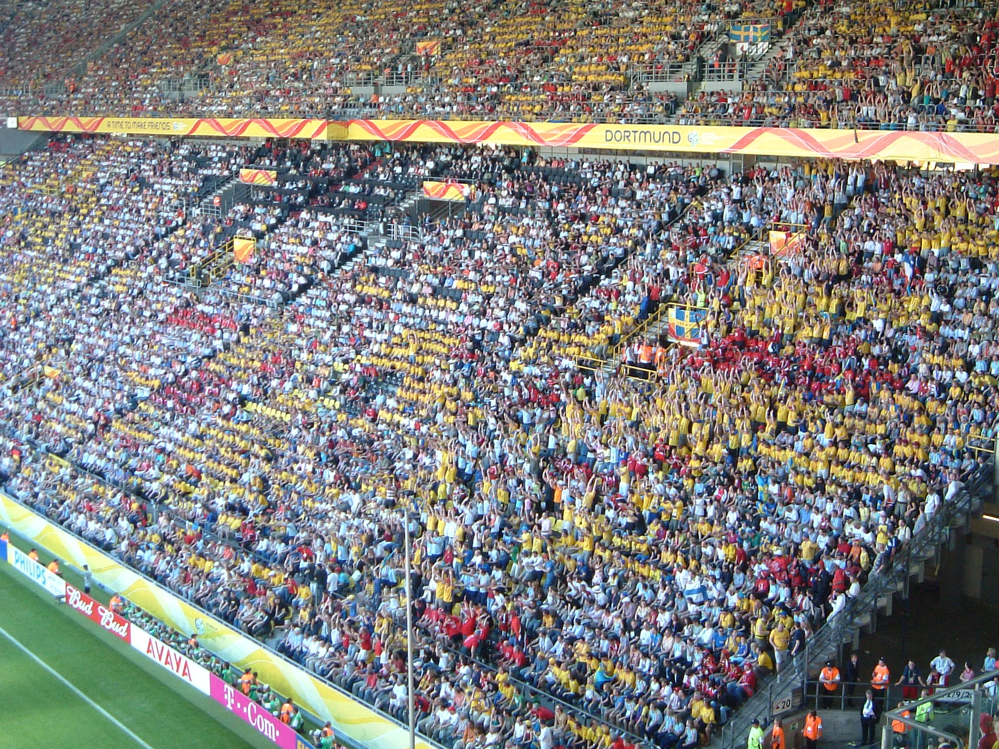

Slide 18
Independent Work
Answer the worksheet about waves and what you know about waves
Finished – complete the Frayer Model for our main vocabulary word of the day – wave

Slide 19
Tues. Feb. 25 Do Now:
Provide 3 examples of how you encounter waves throughout the day
Give the example and what type of wave it is
Example: Ms. Bandoian talking in class is an example of a sound wave.

Slide 20
Objectives:
Learning Intentions –
  Students will be able to identify and label parts of a wave
  Students will be able to construct a wave and measure amplitude and wavelength
Success Criteria –
  We will know we are successful when we can accurately create a wave, label the important parts and measure the wavelength and amplitude

Slide 21
Parts of a Wave
Crest: The high point of a wave
Trough: The low point of a wave
Node: Stationary point, zero displacement

Slide 22
Waves
Amplitude: the largest amount the wave goes up or down from the line of origin
  half the distance between highest and lowest point

Slide 23
Waves
Wavelength (λ): length of one complete cycle of a wave
  The shortest distance in which the wave repeats itself (crest to crest, trough to trough)

Slide 24
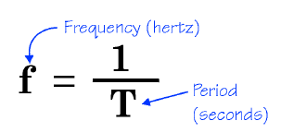
Frequency
Measure of how often a wave goes up and down
  Measured in Hertz (Hz)
A frequency of 1 hertz describes a wave that goes through one complete cycle (or 1 oscillation) every second
Period: time it takes to complete one cycle

Slide 25
Wave on String Simulation
http://phet.colorado.edu/simulations/sims.php?sim=Wave_on_a_String
Measure wavelength
Measure amplitude
Notes:
61,16,8

Slide 26
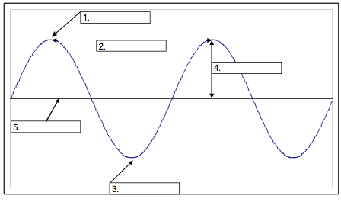

Slide 27
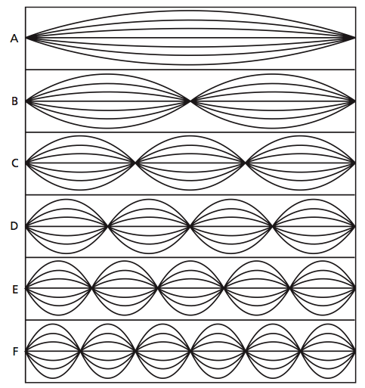
Which wave has the greatest wavelength? The shortest?
Greatest λ
Challenge Question
How many wavelengths are shown in each standing wave?
Shortest λ

Slide 28
As frequency increases, wavelength decreases
Frequency increasing
Wavelength increasing

Slide 29
Wed. Feb. 26 Do Now:
Label the parts of this wave.

Slide 30
Activity: Make Your Own Wave
You will need:
  Piece of construction paper
  2 Pipe Cleaners
  Markers
  Ruler
  Glue or Tape
Make a wave out of a pipe cleaner
  Include a middle line
  Tape or glue to paper
Label the following parts:
  Crest
  Trough
  Wavelength
  Amplitude
Measure the wavelength and amplitude
  Include measurements on your diagram

Slide 31
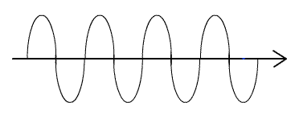
Thurs. Feb. 27 Do Now:
On the wave at the top of your note sheet:
Measure the distance between two crests or two troughs in centimeters (cm). What is this distance?
Measure the distance from the line of origin to a crest or trough in centimeters (cm) . What is this distance?

Slide 32
Objectives
Learning Intentions –
  Students will be able to distinguish between mechanical and electromagnetic waves
  Students will be able to distinguish and depict the difference between longitudinal and transverse waves
Success Criteria –
  We will know we are successful when we can accurately draw longitudinal and transverse waves and provide real examples of each based on the understanding of the difference in their movement

Slide 33

What do Waves Do?
Move energy through matter or space

Slide 34

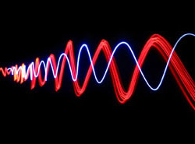
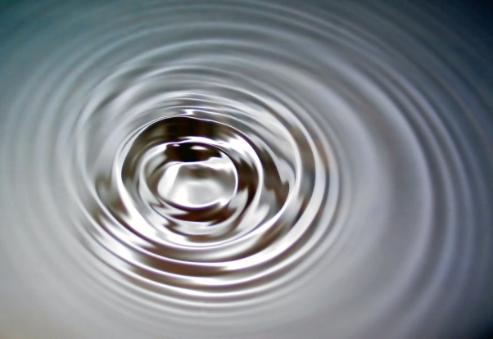
Two Broad Types of Waves
Mechanical Waves need matter (medium) to travel through
Electromagnetic Waves can travel through empty space

Slide 35


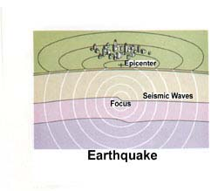
Mechanical Waves
Mechanical waves travel through mediums such as:
water
air
solids

Slide 36

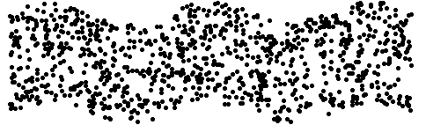
Mechanical Waves
May be longitudinal
Or transverse

Slide 37
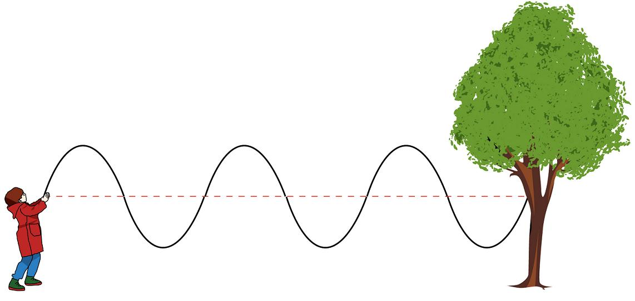
Types of Mechanical Waves
Transverse Waves – energy moves up and down or side to side while traveling forward
  Oscillations not in the direction of the wave
Oscillations
Motion

Slide 38

Types of Mechanical Waves
Longitudinal Waves – energy moves along the medium while traveling forward
  Oscillations in the same direction the wave moves
Motion
Oscillations

Slide 39
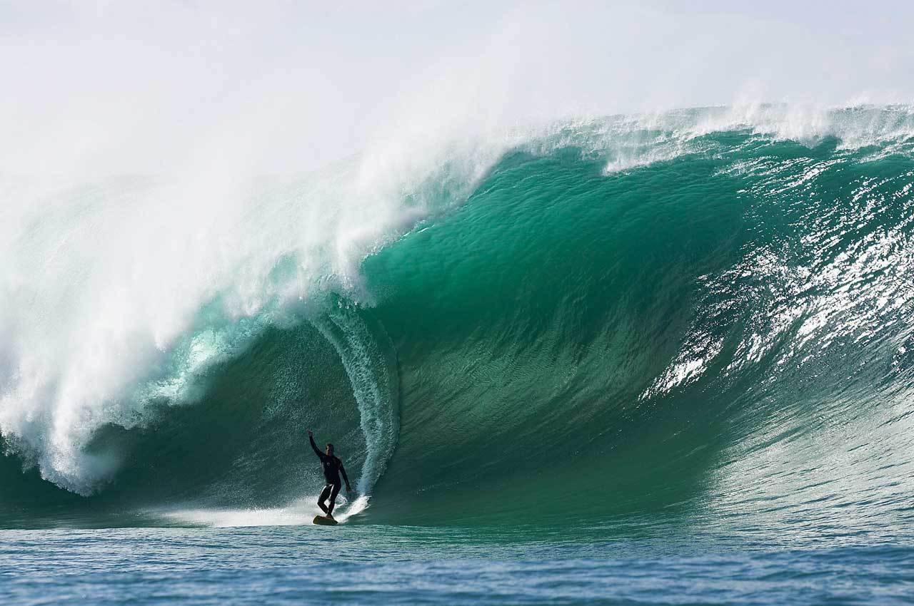
Put the following waves under the correct category:
A wave at a ball game
Guitar string
Slinky
Flag waving in the wind
Sound wave
Shaking a rope
Water wave

Slide 40
II. Mechanical Waves
Longitudinal
Transverse
Slinky
Sound wave
Water wave
A wave at a ball game
Guitar string
Flag waving in the wind
Shaking a rope
Water wave

Slide 41
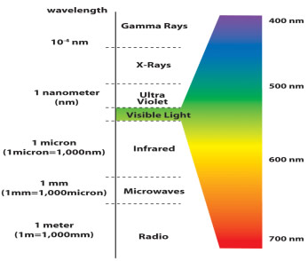
Electromagnetic Waves Includes microwaves, radio waves and light waves

Slide 42
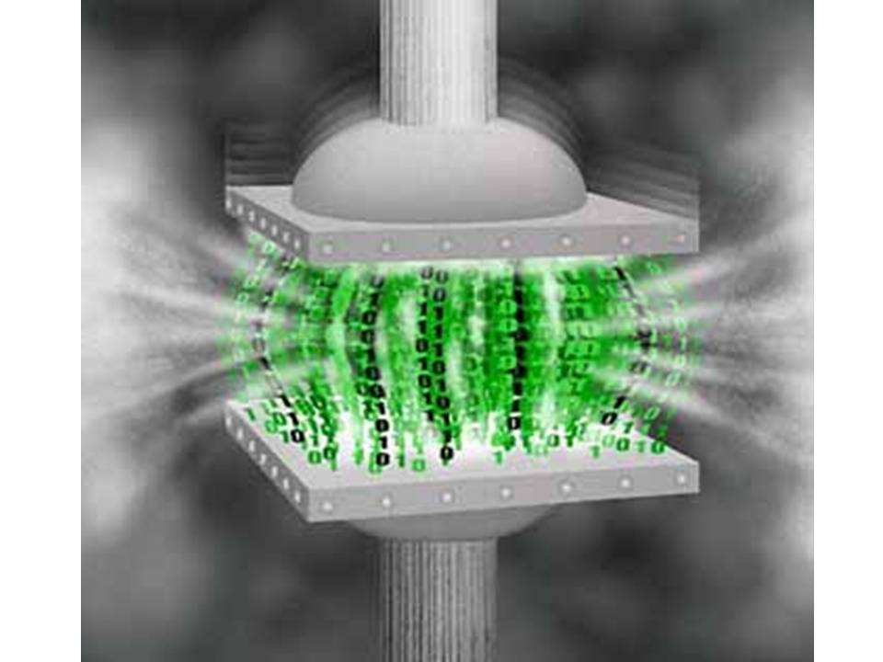
Word of the Day: Compression
Squeeze or decrease in size
Complete the Frayer model for your word of the day!

Slide 43
Fri. Feb. 28 Do Now
Which arrow(s) have the same length as the wave’s amplitude?
Which arrow (s) have the same length as the wave’s wavelength?

Slide 44
Objectives
Learning Intentions –
  Students will be able to calculate speed of a wave using the formula speed = (wavelength) X (frequency)
Success Criteria –
  We will know we are successful when we can accurately solve for the speed of a wave and understand how wavelength and frequency effect the speed of a wave

Slide 45
Slinky Demo: wavelength and frequency
If we shake the slinky slowly, is the frequency high or low?
What happens to the wavelength when we shake the slinky slowly?
If we shake the slinky quickly, is the frequency high or low?
What happens to the wavelength when we shake the slinky quickly?

Slide 46
Wave Speed…
If speed is measured in distance per time, which properties of waves do you think we can use to calculate wave speed?
Wavelength and frequency because they measure distance and time

Slide 47
Wave Speed…
What do you think affects how fast waves travel?
The properties of the medium (not the wave!) affect how fast waves travel
  if they’re solid, liquid, or gas
  how dense the medium is
  temperature

Slide 48
Think about it…
As the wavelength of a wave in a uniform medium increases, its speed will _____.
a. decrease
b. increase
c. remain the same

Slide 49
Check Your Understanding
As the wavelength of a wave in a uniform medium increases, its frequency will _____.
a. decrease
b. increase
c. remain the same

Slide 50

Calculating Wave Speed
The “wave equation” is:
Where v = ________________________
ƒ = ________________________
λ = ________________________
Wave speed or velocity in m/s
Frequency in Hz
Wavelength in meters (m)

Slide 51
Monday Mar. 3 Do Now:
Calculate the speed of a wave that has a frequency of 25 Hz and a wavelength of 3 m.

Slide 52
Solving for Frequency and Wavelength:
Frequency = Speed ÷ Wavelength
Wavelength = Speed ÷ Frequency

Slide 53
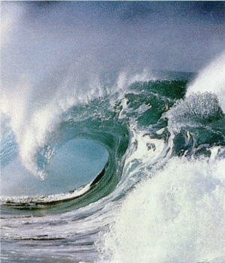
Calculating Wave Speed
In the ocean, a wave has a wavelength of 4 m and a frequency of 2 Hz. What is the wave’s speed?

Slide 54
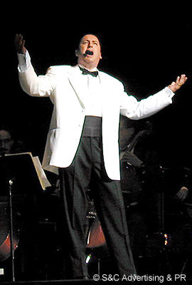
Calculating Wave Speed
Bob sings a high note, which results in a sound wave with a frequency of 512 Hz and a wavelength of 0.66 m. What is the speed of sound?

Slide 55
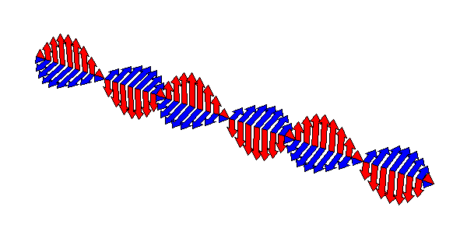
Calculating Wave Speed
A wave is traveling at a speed of 12 m/s and its wavelength is 3 m. What is the wave frequency?

Slide 56
Tues. March 4 Do Now:
Calculate the frequency of a wave that has a speed of 300 m/s and a wavelength of 4 m.
Calculate the wavelength of a wave that has a speed of 420 m/s and a frequency of 60 Hz.

Slide 57
What is a Wave?
A wave is an oscillation that travels from one place to another
  Oscillation: back and forth motion
Carry information and energy over great distance

Slide 58
A wave does NOT carry matter with it! It just moves the matter as it goes through it.
Notes:
Think of a stadium wave: the people are moving up and down, but the wave goes around the stadium

Slide 59
Some waves do not need matter (called a “medium”) to be able to move (for example, through space).
These are called electromagnetic waves (or EM waves).
Some waves MUST have a medium in order to move. These are called mechanical waves.

Slide 60
Radio Waves
Carries sound to your stereo
Carries television signals
WiFi
MRI – magnetic resonance imaging
  Uses radio waves to generate images of the human body

Slide 61
Properties ALL Types of Waves have in common
Back and forth movement
Carry energy
  Waves also carry information such as sound, pictures, or even numbers.

Slide 62
Parts of a Wave
Crest: The high point of a wave
Trough: The low point of a wave
Node: Stationary point, zero displacement

Slide 63
Waves
Amplitude: the largest amount the wave goes up or down from the line of origin
  half the distance between highest and lowest point

Slide 64
Waves
Wavelength (λ): length of one complete cycle of a wave
  The shortest distance in which the wave repeats itself (crest to crest, trough to trough)

Slide 65
Frequency
Measure of how often a wave goes up and down
  Measured in Hertz (Hz)
A frequency of 1 hertz describes a wave that goes through one complete cycle (or 1 oscillation) every second
Period: time it takes to complete one cycle

Slide 67
Which wave has the greatest wavelength? The shortest?
Greatest λ
Challenge Question
How many wavelengths are shown in each standing wave?
Shortest λ

Slide 68
Mechanical Waves
May be longitudinal
Or transverse

Slide 69
Calculating Wave Speed
The “wave equation” is:
Where v = ________________________
ƒ = ________________________
λ = ________________________
Wave speed or velocity in m/s
Frequency in Hz
Wavelength in meters (m)

Slide 70
Solving for Frequency and Wavelength:
Frequency = Speed ÷ Wavelength
Wavelength = Speed ÷ Frequency

