Slide 1
Tues. Mar. 4 Do Now
Which arrow(s) have the same length as the wave’s amplitude?
Which arrow (s) have the same length as the wave’s wavelength?

Slide 2
What is a Wave?
A wave is an oscillation that travels from one place to another
  Oscillation: back and forth motion
Carry information and energy over great distance

Slide 3


A wave does NOT carry matter with it! It just moves the matter as it goes through it.
Notes:
Think of a stadium wave: the people are moving up and down, but the wave goes around the stadium

Slide 4
Some waves do not need matter (called a “medium”) to be able to move (for example, through space).
These are called electromagnetic waves (or EM waves).
Some waves MUST have a medium in order to move. These are called mechanical waves.

Slide 5

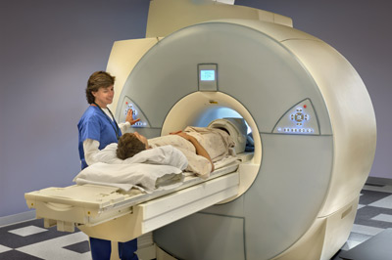
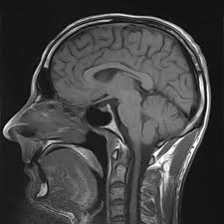
Radio Waves
Carries sound to your stereo
Carries television signals
WiFi
MRI – magnetic resonance imaging
  Uses radio waves to generate images of the human body

Slide 6
Properties ALL Types of Waves have in common
Back and forth movement
Carry energy
  Waves also carry information such as sound, pictures, or even numbers.

Slide 7
Parts of a Wave
Crest: The high point of a wave
Trough: The low point of a wave
Node: Stationary point, zero displacement

Slide 8
Waves
Amplitude: the largest amount the wave goes up or down from the line of origin
  half the distance between highest and lowest point

Slide 9
Waves
Wavelength (λ): length of one complete cycle of a wave
  The shortest distance in which the wave repeats itself (crest to crest, trough to trough)

Slide 10
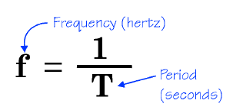
Frequency
Measure of how often a wave goes up and down
  Measured in Hertz (Hz)
A frequency of 1 hertz describes a wave that goes through one complete cycle (or 1 oscillation) every second
Period: time it takes to complete one cycle

Slide 11
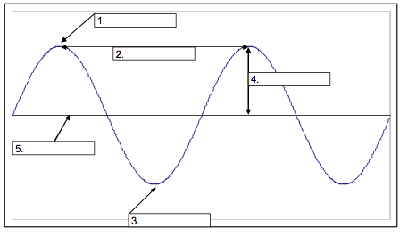

Slide 12
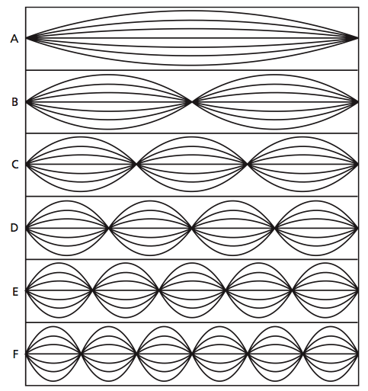
Which wave has the greatest wavelength? The shortest?
Greatest λ
Challenge Question
How many wavelengths are shown in each standing wave?
Shortest λ

Slide 13

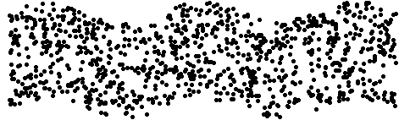
Mechanical Waves
May be longitudinal
Or transverse

Slide 14

Calculating Wave Speed
The “wave equation” is:
Where v = ________________________
ƒ = ________________________
λ = ________________________
Wave speed or velocity in m/s
Frequency in Hz
Wavelength in meters (m)

Slide 15
Solving for Frequency and Wavelength:
Frequency = Speed ÷ Wavelength
Wavelength = Speed ÷ Frequency

