Slide 1
Do Now:
What is the difference between incandescent and fluorescent lights?
What makes up white light?
Which is hotter: a blue or red flame?

Slide 2
The electromagnetic spectrum
Learning Intentions:
Recall the order of the EM spectrum.
Describe the properties of waves in the EM spectrum.
Evaluate the uses and dangers of the EM spectrum.

Slide 3
Visible light is an EM wave. Just as we can hear only some frequencies of sound, we can only see some frequencies of EM waves. There are six more types of EM waves which we cannot see.

Slide 4
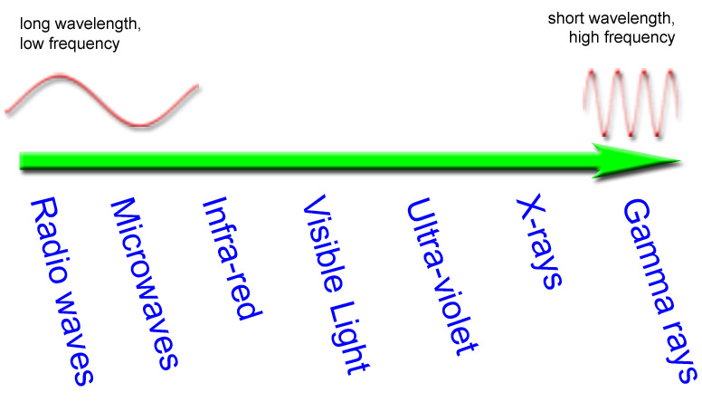
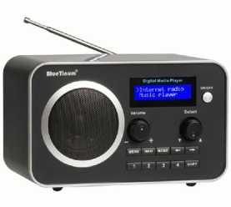
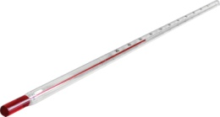
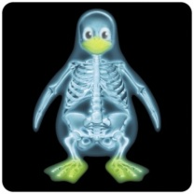
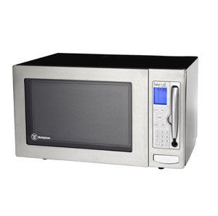
The electromagnetic spectrum
Notes:
4

Slide 5
ELECTROMAGNETIC SPECTRUM
740nm
370nm

Slide 6
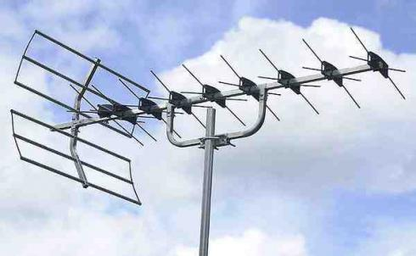
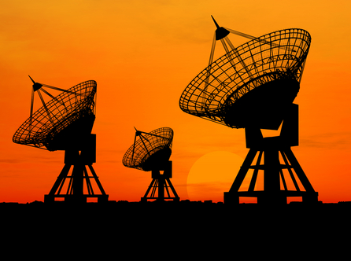
RADIOWAVES
Wavelength: 1m to 100000m
Frequency: 3 x 10⁹ to 3 x 10⁴ Hz
Uses: Telecommunications, TV, Radio
Dangers: none

Slide 7
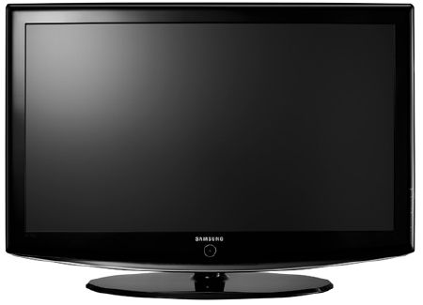
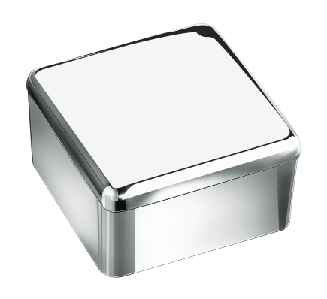
We use radio waves to listen to the radio and watch TV.
The radio changes the signal into sound, and the TV changes it into pictures.
Radio waves are stopped easily by metal.

Slide 8
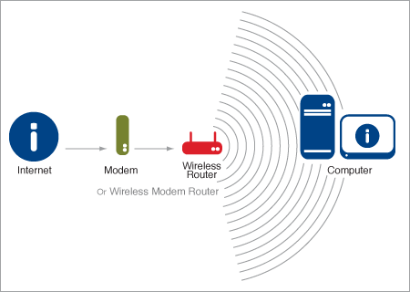
Wireless routers use radio waves to let you connect to the internet without a cable.

Slide 9
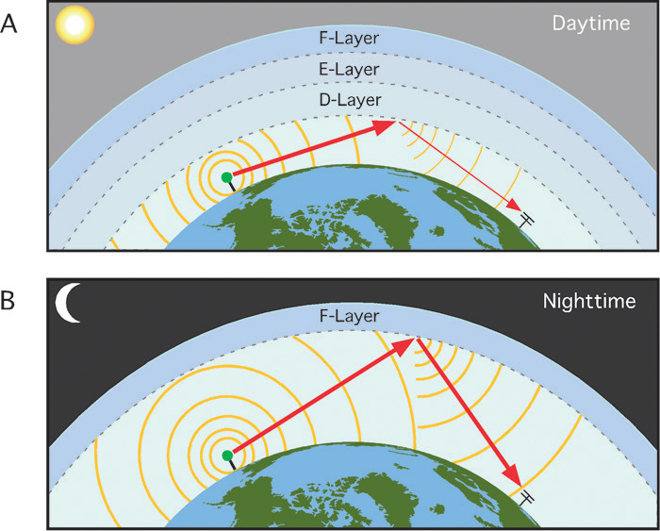
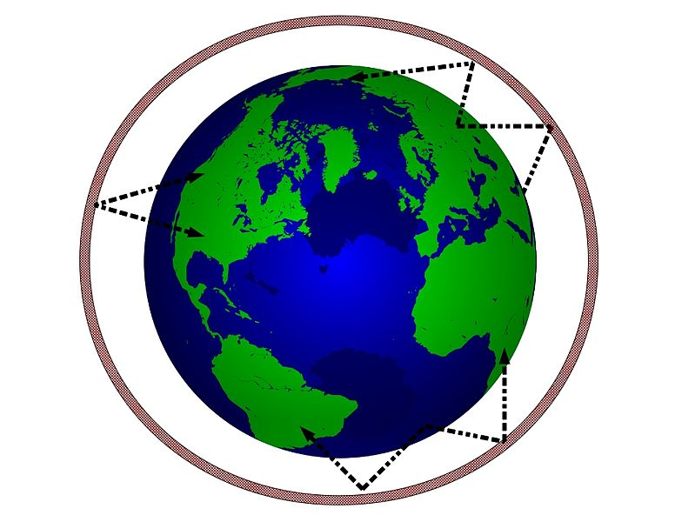
This means we can send signals over long distances by bouncing the signal off the atmosphere.
Radio waves travel in straight lines. Part of the atmosphere round the earth can reflect radio waves.

Slide 10
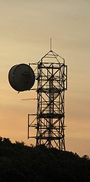
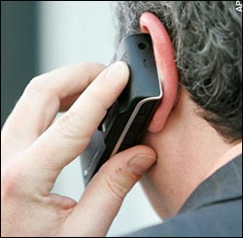
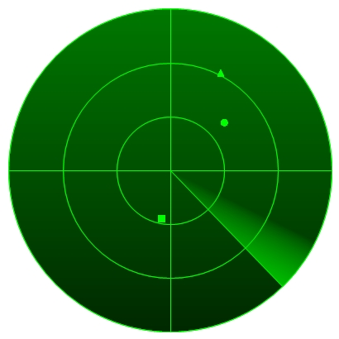
MICROWAVES
Wavelength: 0.001m to 1m
Frequency: 3 x 10¹² to 3 x 10⁹ Hz
Uses: Telecommunications, RADAR, Cooking
Dangers: can produce burns, clouds eye, cancer (?)

Slide 11
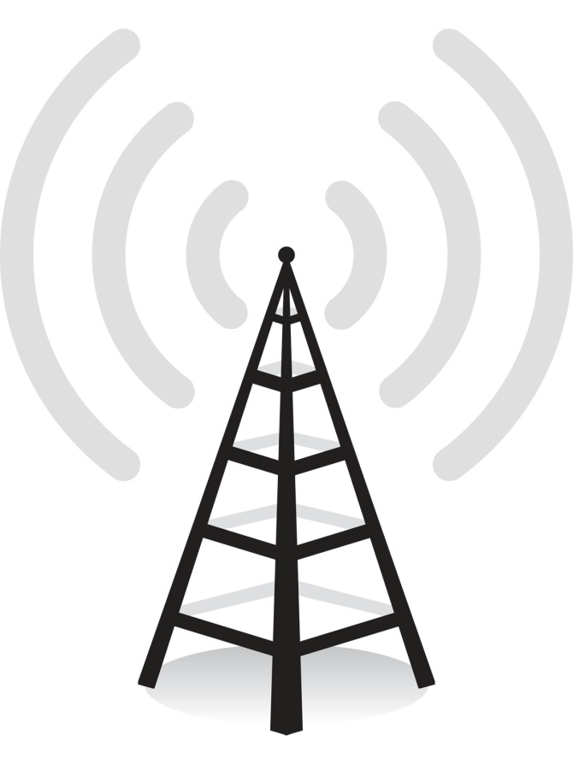
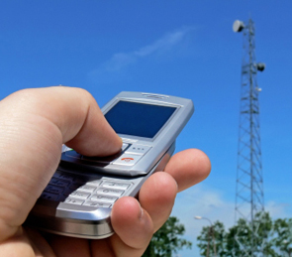
Mobile phones use microwaves to send the phone signal.

Slide 12
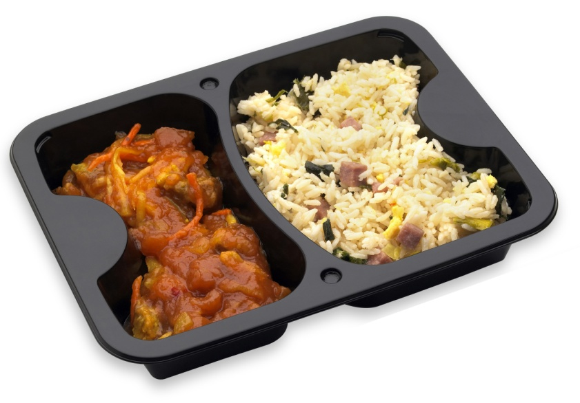
Microwaves
Microwaves are used for cooking food.
So what happens?
Food has water inside it.
The microwaves make the water in the food vibrate.
The water molecules bang into each other.
This makes friction, which makes heat.

Slide 13
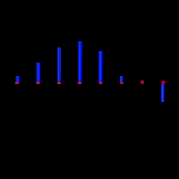
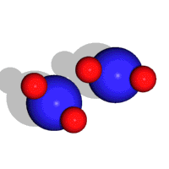
microwave
water in food

Slide 14
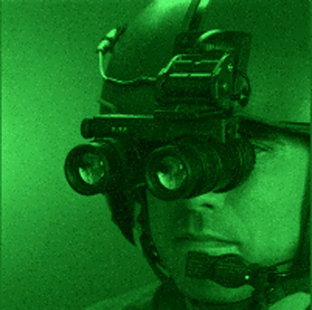
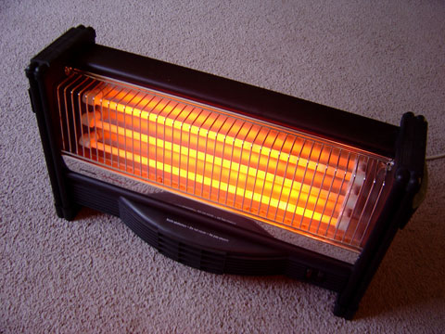
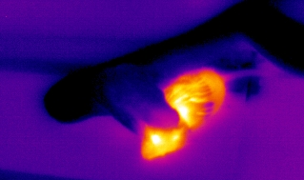
INFRA-RED
Wavelength: 740nm to 0.01m
Frequency: 4 x 10¹⁴ to 3 x 10¹¹ Hz
Uses: Heating, cooking, TV remotes, night-vision
Dangers: can burn

Slide 15
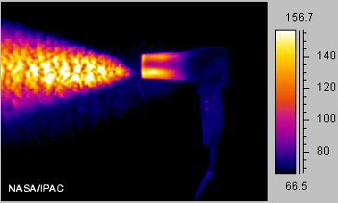
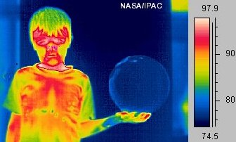
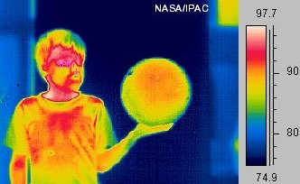
Infra-red
What do these pictures show?
They show how hot something is.
This heat energy is infra red radiation.

Slide 16
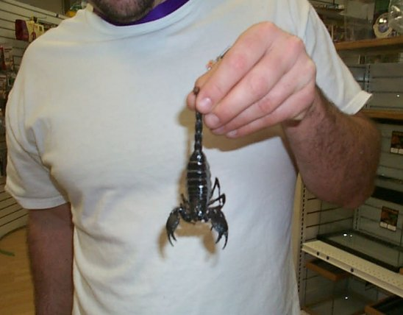
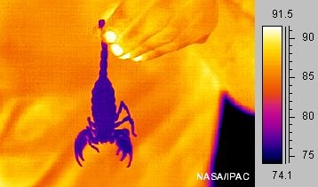
We can see infra red radiation using a thermal camera.
How is this useful?

Slide 17
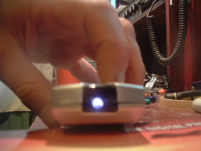
This is the infra red radiation. The camera can see it, even though your eyes can’t!

Slide 18
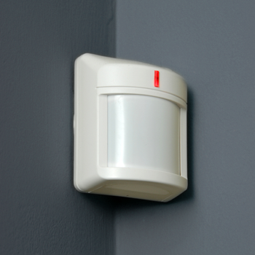
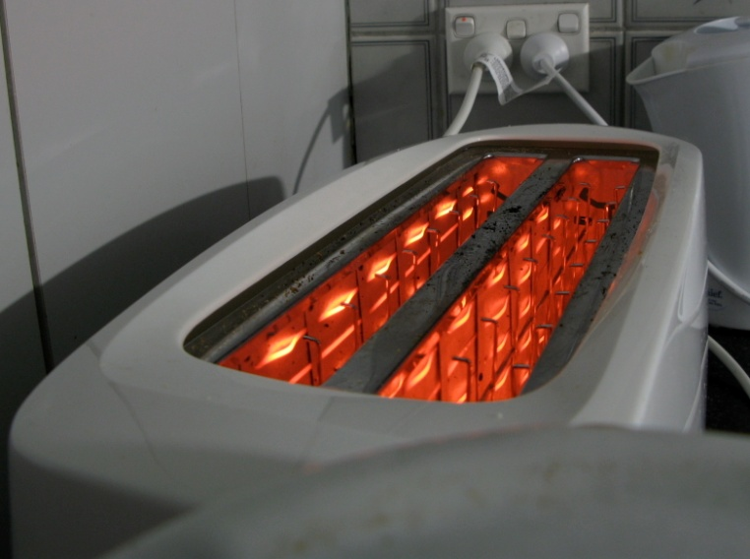
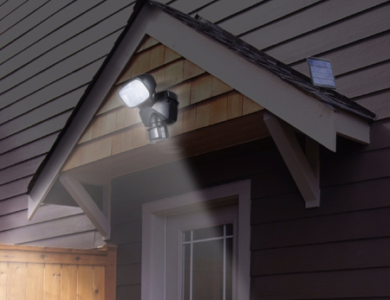
What else can we use infra red radiation for?

Slide 19
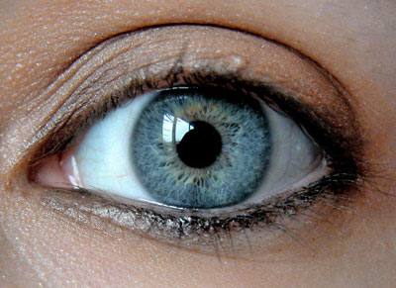
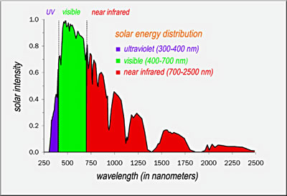
VISIBLE LIGHT
Wavelength: 370nm (violet) to 740nm (red)
Frequency: 8 x 10¹⁴ to 4 x 10¹⁴ Hz
Uses: seeing
Dangers: eye damage from bright lights
Visible light is best at getting through our atmosphere – which is why we use it to see!

Slide 20
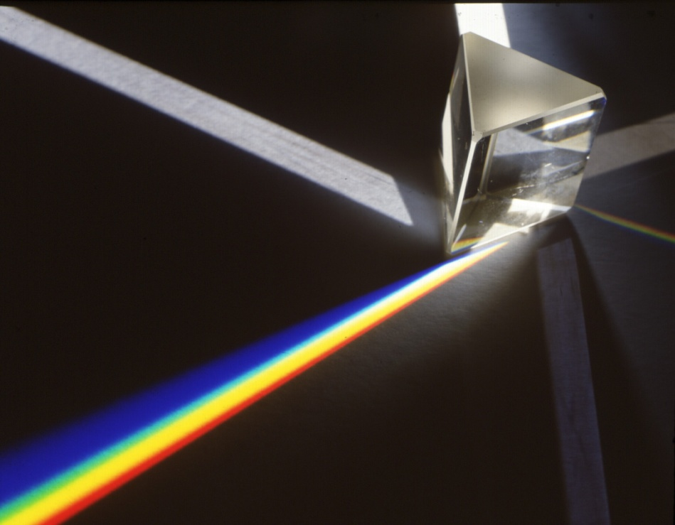
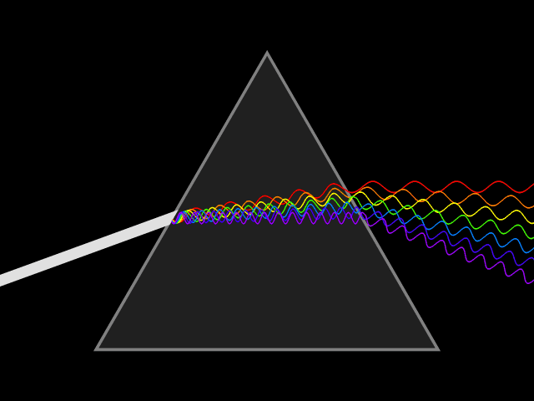
Light
White light is made up of different colors.
We can see this in a rainbow.
But what’s happening?
The drops of water in the air are splitting the light from the sun into its different colors.
REFRACTION

Slide 21
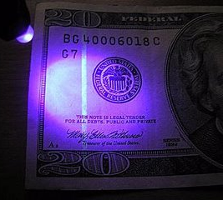
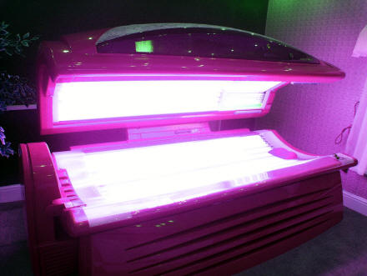
ULTRAVIOLET
Wavelength: 10⁻⁹ m to 370nm
Frequency: 3 x 10¹⁷ to 8 x 10¹⁴ Hz
Uses: tanning salons, fake money detections, pollination
Dangers: skin cancer
Bees see in UV to help them find pollen!

Slide 22
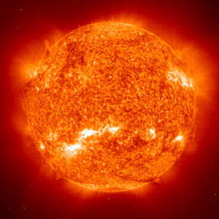
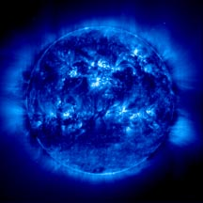
Ultraviolet
Ultraviolet radiation comes from the sun.

Slide 23
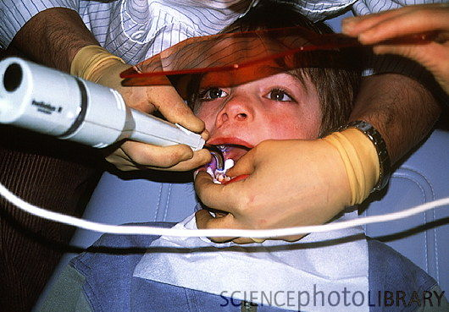
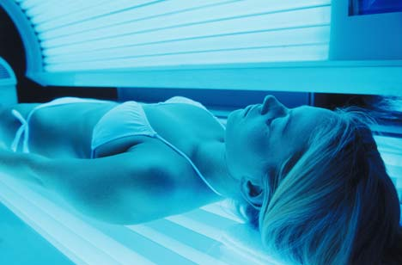
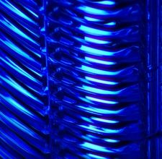
UV can be useful
BUT…ultraviolet light causes sunburn.

Slide 24
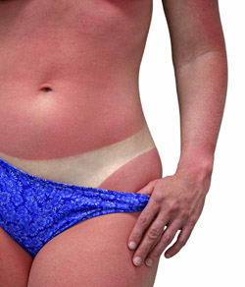
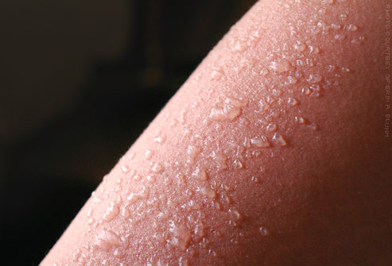
Skin cells absorb the UV radiation.
The energy of the radiation causes damage to the cell.
Blood travels to the skin to try and fix the damage.
This is why skin goes red.

Slide 25
How can you protect yourself from sunburn?
Ingredients in sun screen reflect and scatter UV radiation or absorb the radiation and turn it into heat.

Slide 26
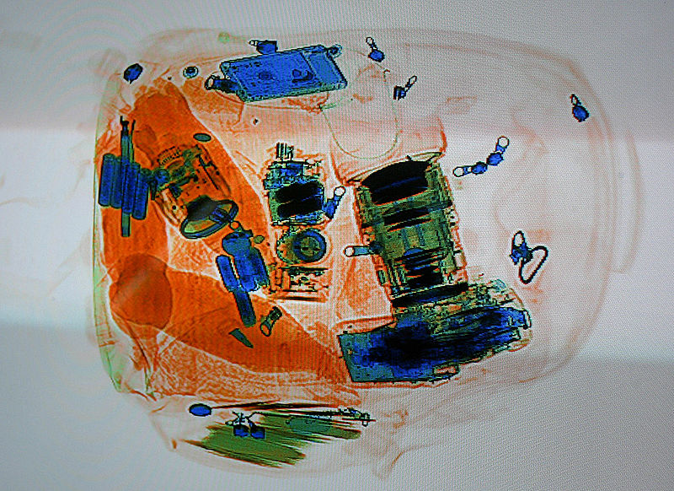
X-RAYS
Wavelength: 10⁻¹² to 10⁻⁷ m
Frequency: 3 x 10²⁰ to 3 x 10¹⁵ Hz
Uses: medical imagery, security
Dangers: cancer

Slide 27
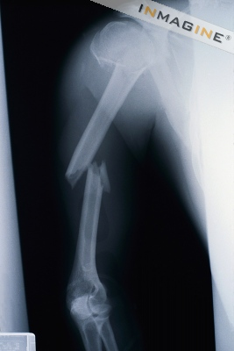
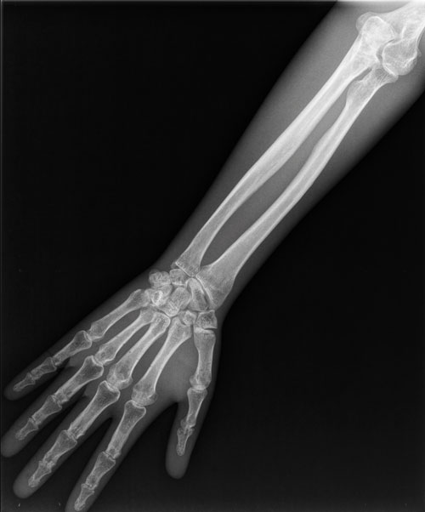
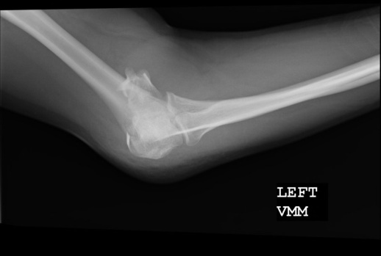
X-rays
We can use x-rays to look inside the body instead of cutting it open.

Slide 28
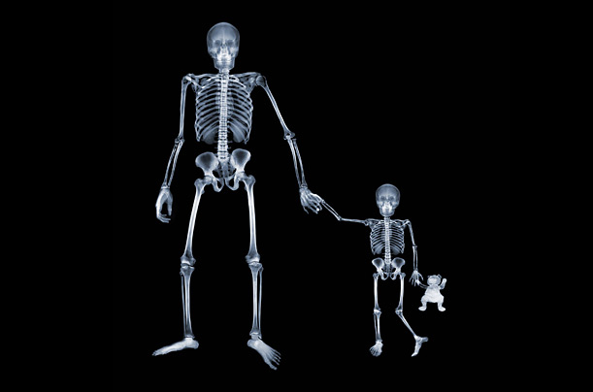
How do x-rays work?
When x-rays hit your body, most go straight through you.
When an x-ray hits a bone, the bone absorbs it, so the x-rays
do not get to the film.
This makes the bone look white on the x-ray photograph.

Slide 29
Are x-rays safe?
In small doses, yes.
Big doses of x-rays can damage your body, causing cancer.
People who use x-rays have to protect themselves.
X-rays can damage unborn babies, so pregnant women have to protect themselves too.

Slide 30
GAMMA RAYS
(γ)
Wavelength: 10⁻¹⁶ to 10⁻⁹ m
Frequency: 3 x 10²⁴ to 3 x 10¹⁷ Hz
Uses: cancer treatment, observing the universe
Dangers: cancer

Slide 31
Gamma radiation
Gamma radiation is the most dangerous type of radiation.
It causes radiation sickness.
It can also cause cancer.
The more radiation you are exposed to, the more ill you will be.

Slide 33
Where does it come from?

Slide 34
Is it ever useful?
Yes – because it is dangerous to cells, it can be used to kill cancer cells.
This is called radiotherapy.

Slide 35
It is important that the gamma radiation hits the cancer without hitting too many of the healthy cells.
To do this, more than one beam of radiation is used.
This means that less of the healthy cells are damaged by the radiation.
http://www.insidestory.iop.org/insidestory_flash1.html

Slide 36
The Dangers of the EM Spectrum
As the frequency increases, wavelength gets smaller. Eventually the waves are so small that they can interact with cells, DNA and atoms.

Slide 37
What is the link?
They all travel as electromagnetic waves!

Slide 38
Create a mnemonic to remember the order of the EM spectrum
Radio
Microwaves
Infrared
Visible light
Ultraviolet
X rays
Gamma

